Slide 1
ICE-3107: SIGNALS AND SYSTEMS
Dr. Mohammad Amzad Hossain
Associate Professor
Department of Information & Communication Engineering
Noakhali Science & Technology University
Notes:
Optimisation of the Beer Distribution Game

Slide 2
Introduction
The concept and theory of signals and systems are needed in almost all electrical/electronic engineering fields and in many other engineering and scientific disciplines as well.
Advances in technology are improving capabilities of analyzing difference information sources such as audio (speech, music), image (video, multimedia, medical scans), medical signals (heart rate, blood pressure, brain activity) and remote sensing data (geophysical, radar, sonar). The disciplines of signal and image processing are concerned with the analysis of signals and their interaction with systems.
Notes:
Optimisation of the Beer Distribution Game

Slide 3
Introduction
In communications, the objective is to transfer information (signals) from one or many sources to one or many destinations, which requires the design of transmission schemes (e.g., modulation and coding), receivers, and filters. The Signal Systems and Communications area covers the fundamentals of analog and digital signals and systems, the mathematical tools for the analysis of deterministic and random signals, and applications to digital signal processing, digital image processing, and digital/analog communications.
Notes:
Optimisation of the Beer Distribution Game

Slide 4
Signal and System
A signal is a physical quantity that varies with time, space, or any other independent variable by which information can be carried/ conveyed. Here independent variable is time. For example:
x(t) = 5t
y(t) = sin(2πft)
A System is any physical set of components or a function of several devices that takes a signal in input, and produces a signal as output.
Let x and y be the input and output signals, respectively, of a system. Then the system is viewed as a transformation of x into y. This transformation is represented by the mathematical notation:
y = Tx
For example, a filter used to remove the noise from desired signal.
Notes:
Optimisation of the Beer Distribution Game

Slide 5
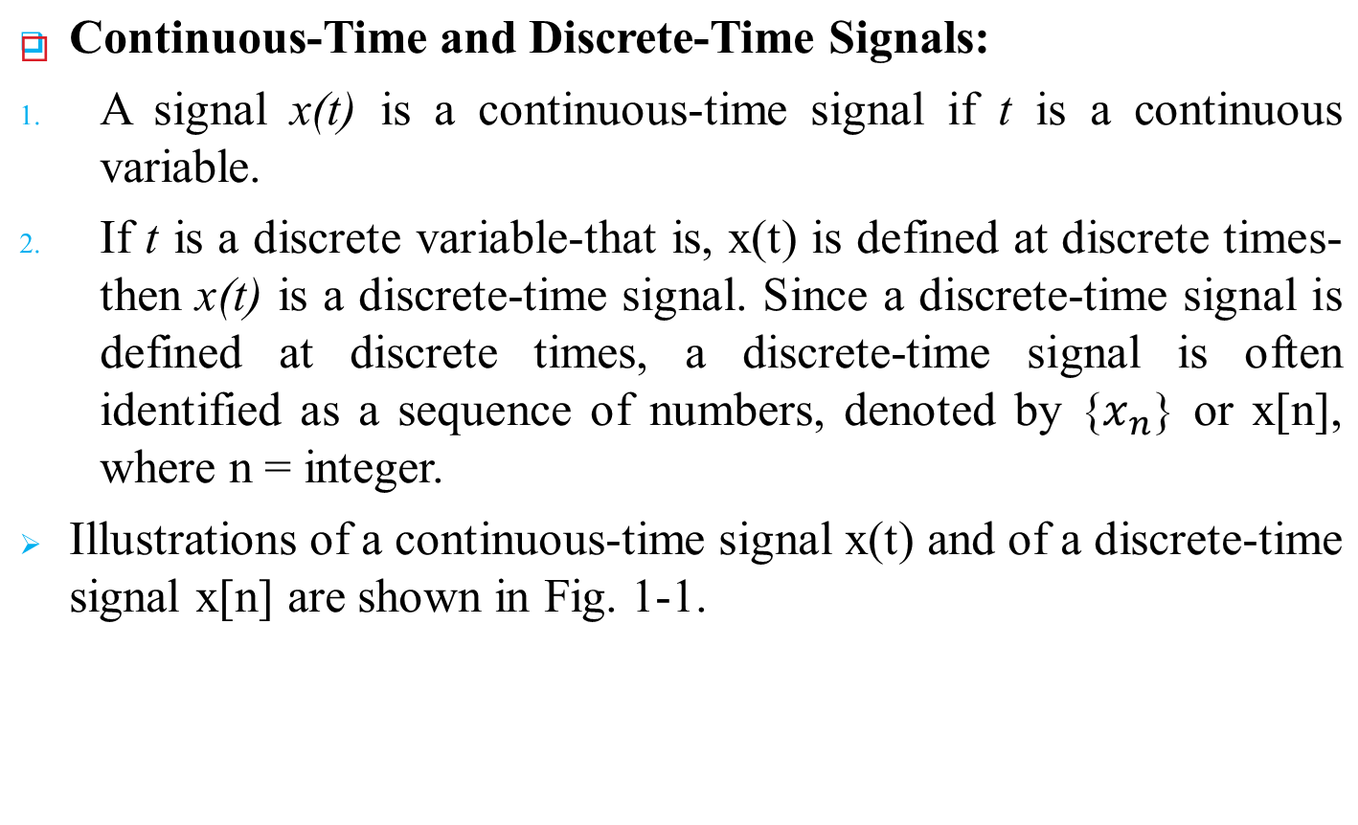
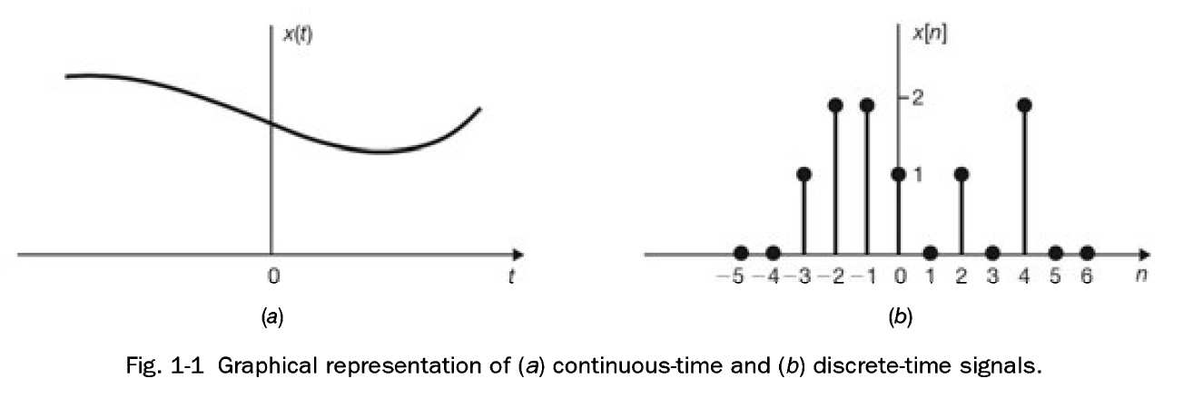
Classification of Signal
Notes:
Optimisation of the Beer Distribution Game

Slide 6
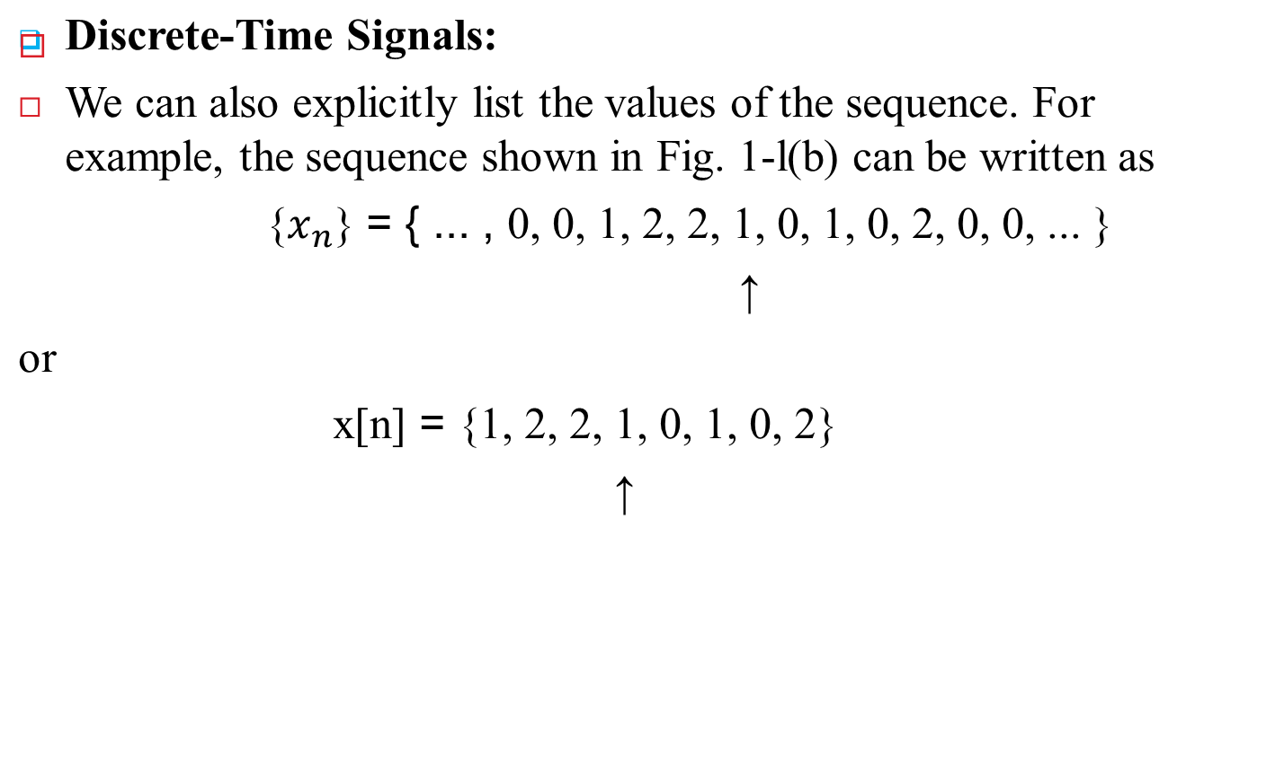
Classification of Signal
Notes:
Optimisation of the Beer Distribution Game

Slide 7
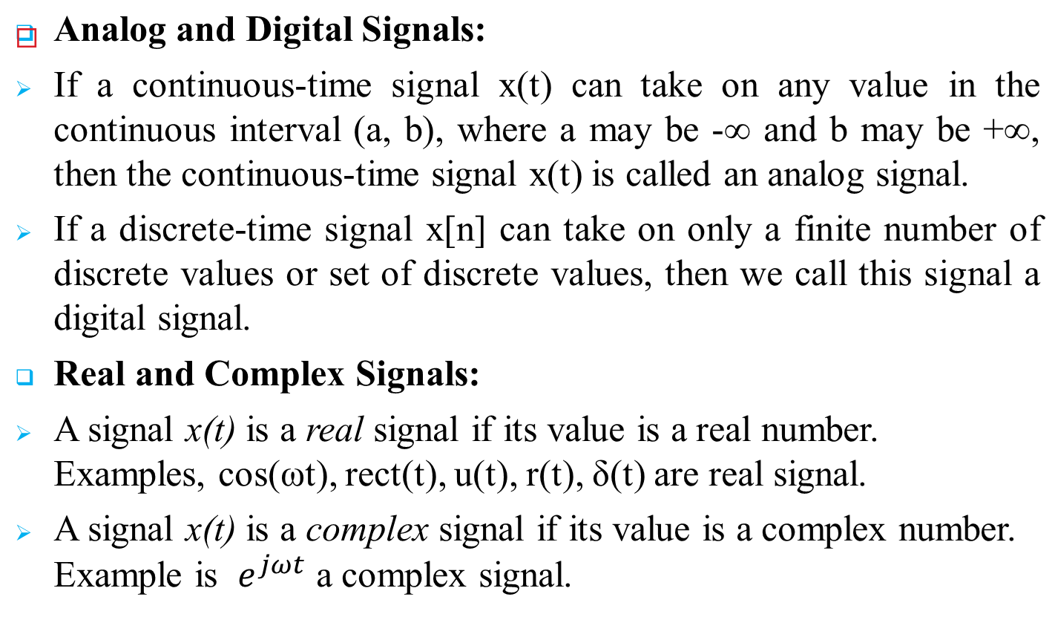
Classification of Signal
Notes:
Optimisation of the Beer Distribution Game

Slide 8
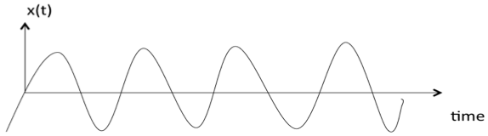
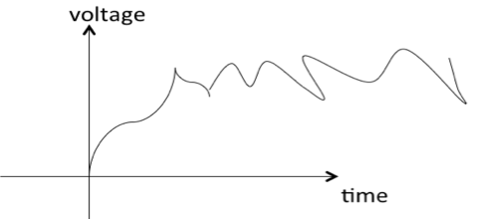
Classification of Signal
Deterministic and Random Signals:
A signal is said to be deterministic if there is no uncertainty with respect to its value at any instant of time. Or, signals which can be defined exactly by a mathematical formula are known as deterministic signals.
A signal is said to be random/non-deterministic if there is uncertainty with respect to its value at some instant of time. Random signals cannot be described by a mathematical equation.
Notes:
Optimisation of the Beer Distribution Game

Slide 9
Classification of Signal
Multichannel and Multidimensional Signals:
Multichannel signals refer to signals that consist of multiple channels of information. Each channel represents a different stream of data or information. These channels could correspond to different sources, or different components of a signal (such as frequency bands in a frequency-division multiplexing system).
For example:
In color image processing, there are usually three channels: red, green, and blue.
In telecommunications, multiplexing techniques can create multichannel signals where different information streams are transmitted simultaneously over the same medium but on different frequency bands or time slots.
Notes:
Optimisation of the Beer Distribution Game

Slide 10
Classification of Signal
Multichannel and Multidimensional Signals:
Multidimensional signals extend the concept of signals beyond one-dimensional sequences to include signals that have multiple dimensions. These dimensions could represent different aspects of the signal or different variables.
For example:
Images are two-dimensional signals, with dimensions corresponding to width and height. Each pixel in the image represents a value in two dimensions.
Videos are typically three-dimensional signals, with dimensions corresponding to width, height, and time. Each frame of the video is a two-dimensional image, and the sequence of frames adds the time dimension.
Notes:
Optimisation of the Beer Distribution Game

Slide 11
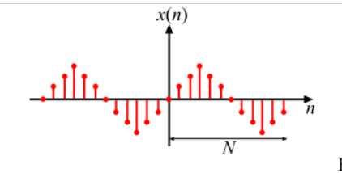
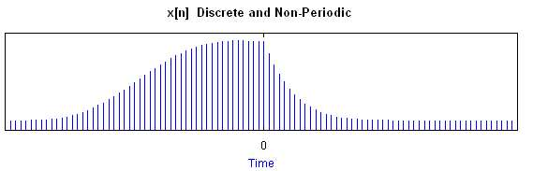
Classification of Signal
Periodic and Nonperiodic Signals:
A signal is said to be periodic if it satisfies the condition x(t) = x(t + T) or x[n] = x[n + N]. Where T and N = fundamental time period.
A signal is said to be non-periodic if it does not repeat itself after a fixed time period or does not repeat at all. The non periodic signal do not satisfy the condition of periodicity stated in equation x(t) ≠ x(t+T₀) or x[n] ≠ x[n + N].
Notes:
Optimisation of the Beer Distribution Game

Slide 12
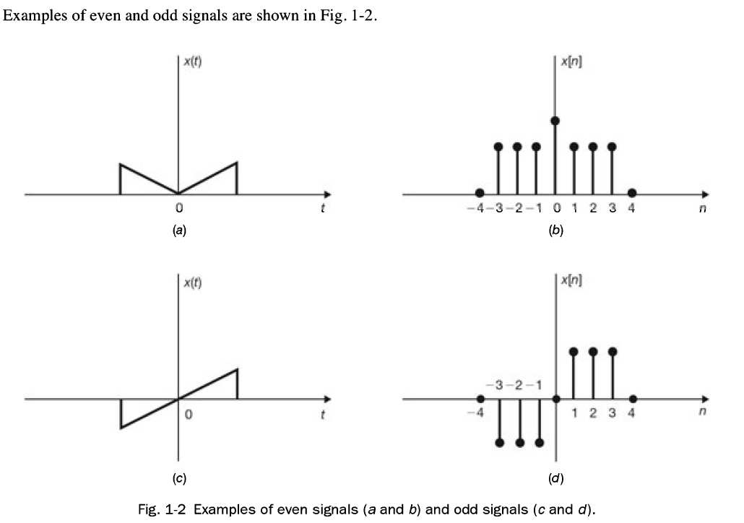
Classification of Signal
Even and Odd Signals:
A signal x(t) or x[n] is referred to as an even signal if
x(-t) = x(t)
x[ -n] = x[n]
A signal x(t) or x[n] is referred to as an odd signal if
x(-t) = -x(t)
x[-n] = -x[n]
Notes:
Optimisation of the Beer Distribution Game

Slide 13
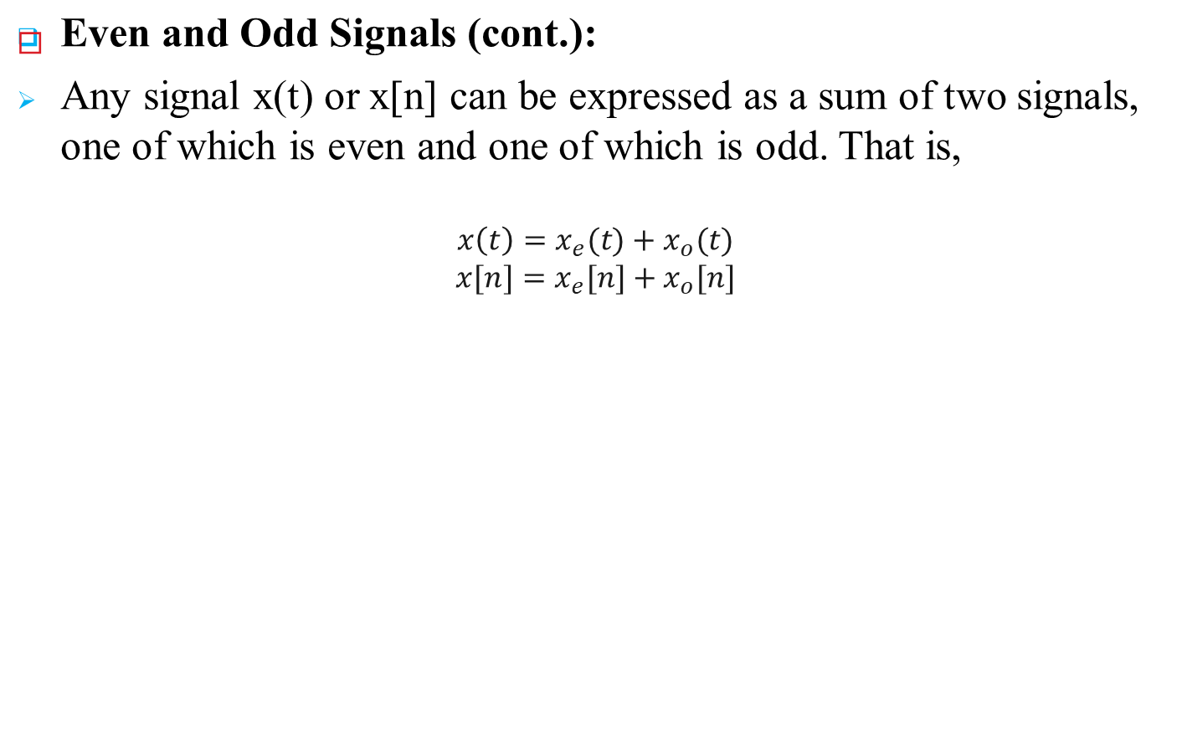
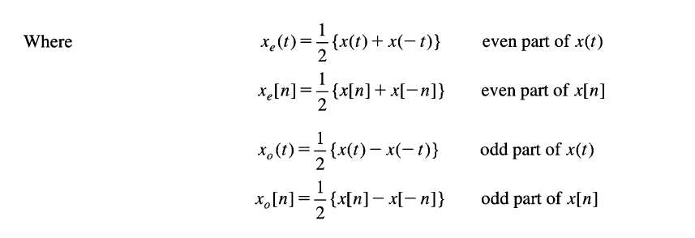
Classification of Signal
Notes:
Optimisation of the Beer Distribution Game

Slide 14
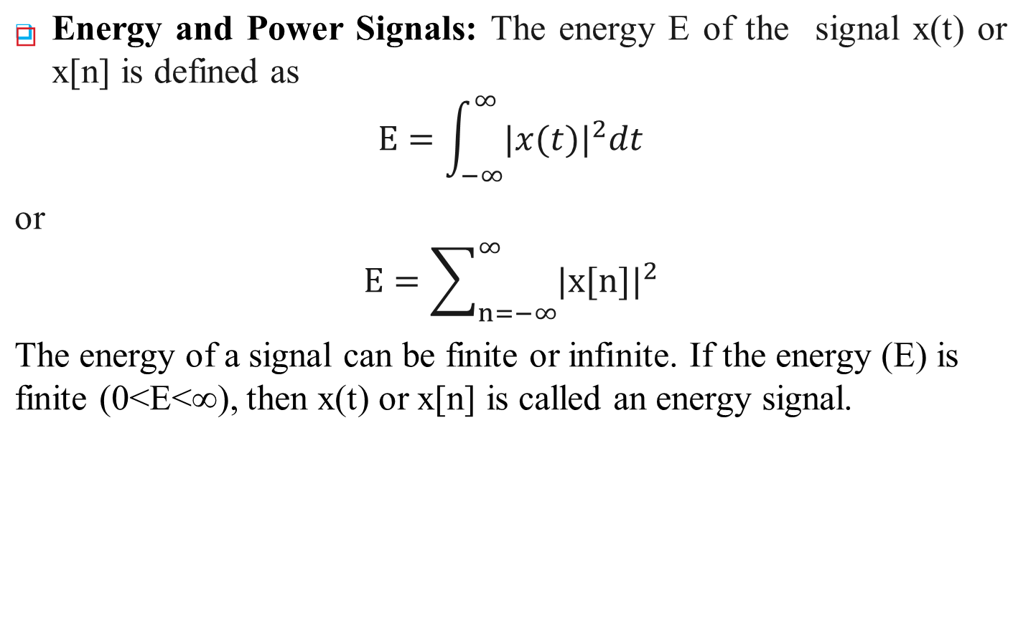
Classification of Signal
Notes:
Optimisation of the Beer Distribution Game

Slide 15
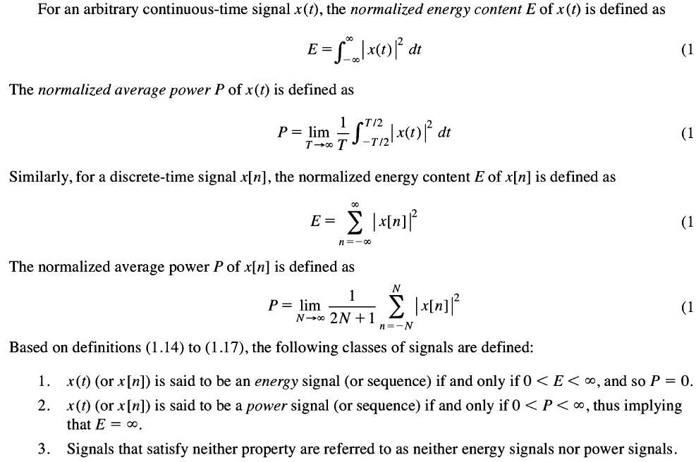
Classification of Signal
Energy and Power Signals (cont.):
Notes:
Optimisation of the Beer Distribution Game

Slide 16
What are the prerequisites for the signals and systems course?
You need to know fluent in the following topics:
Differential equations and Integrals (advanced level)
Laplace transform (shares a lot with Fourier transforms)
Ordinary differential equations (and inverse Laplace transform)
Complex numbers (and complex Laplace transform)
Series and expansions
Fourier analysis (and complex Fourier Series/transform)
Then you can step into signals and systems.
Notes:
Optimisation of the Beer Distribution Game

